Slide 1
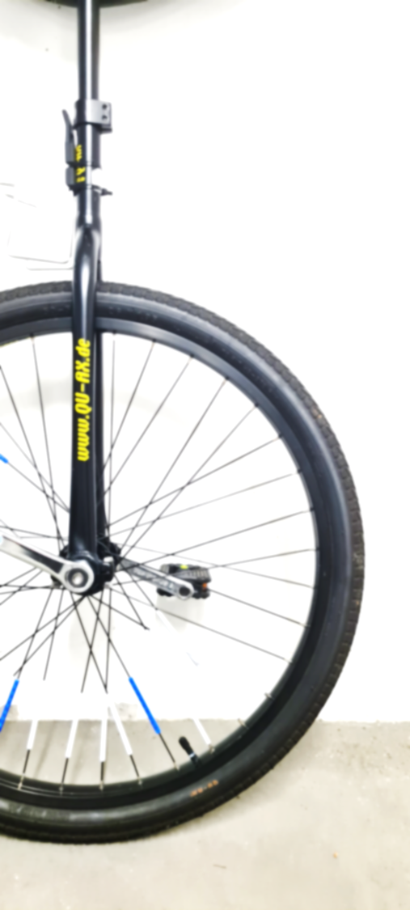
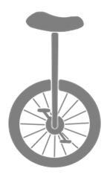
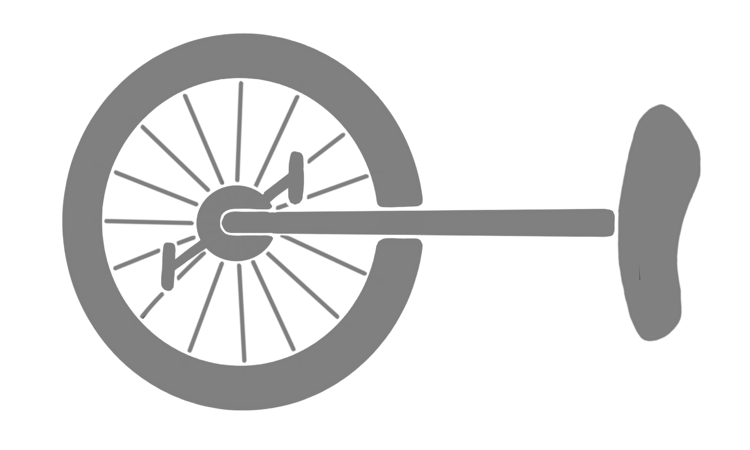

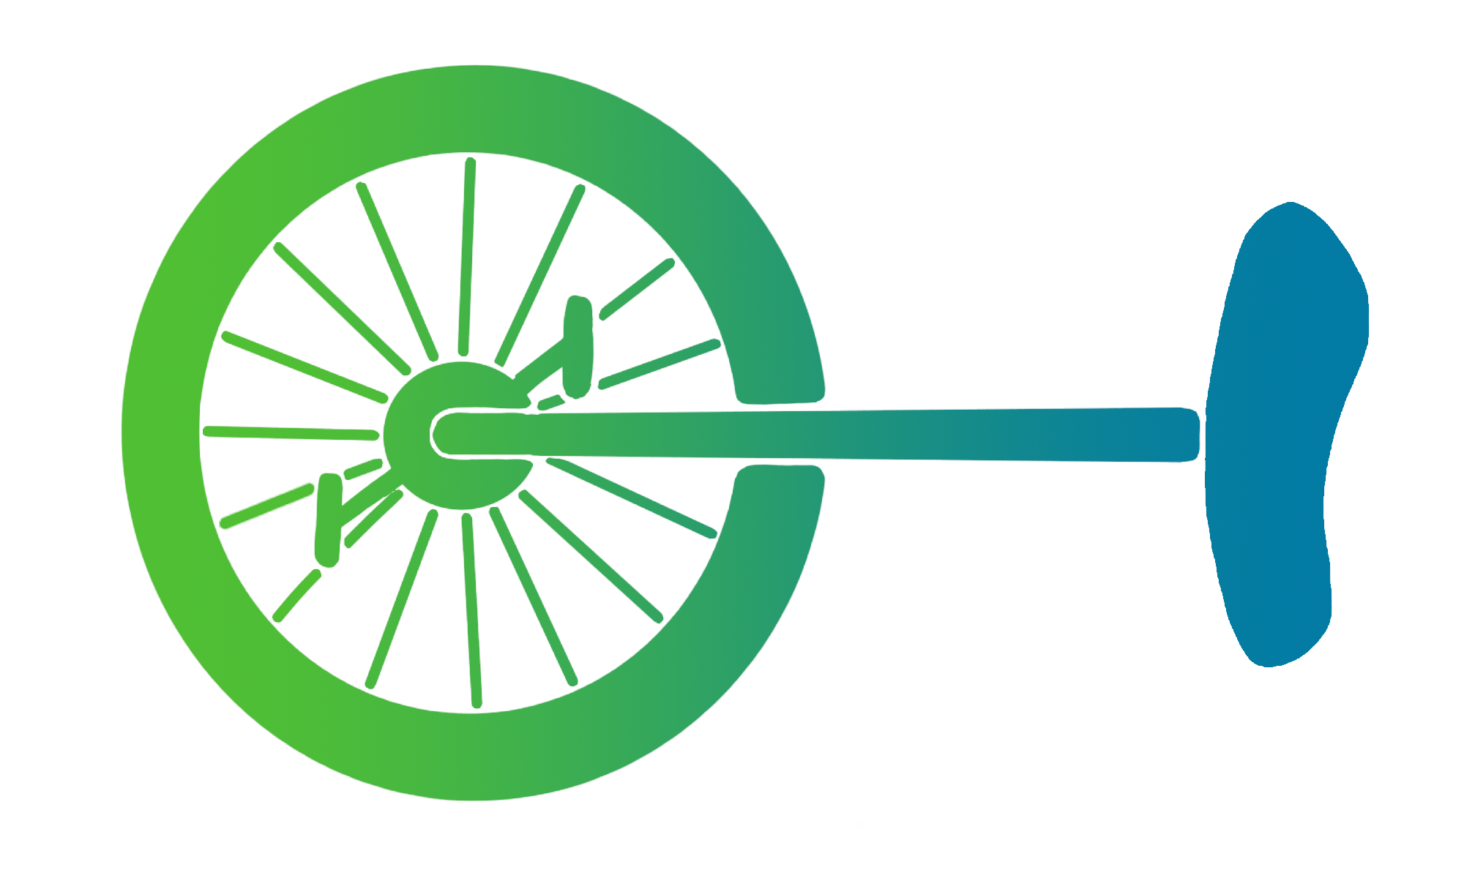
Optimizing the Street Safety of a Unicycle Through Maths-Inspired Decorations
Kristin Ohlmann
Notes:
So, a while ago I was riding my unicycle around the nearby lake. There was some bad planning involved, and I found myself on a road with no bike paths in sight. And that got me thinking I should probably do something about the visibility of that thing. There are some tiny reflectors on the pedals that keep falling off, but other than that? Nothing.
I did not really know how I wanted to do that until I stumbled across my old unicycle. And I remembered that as a child I often used crepe-paper to decorate the wheel.

Slide 2
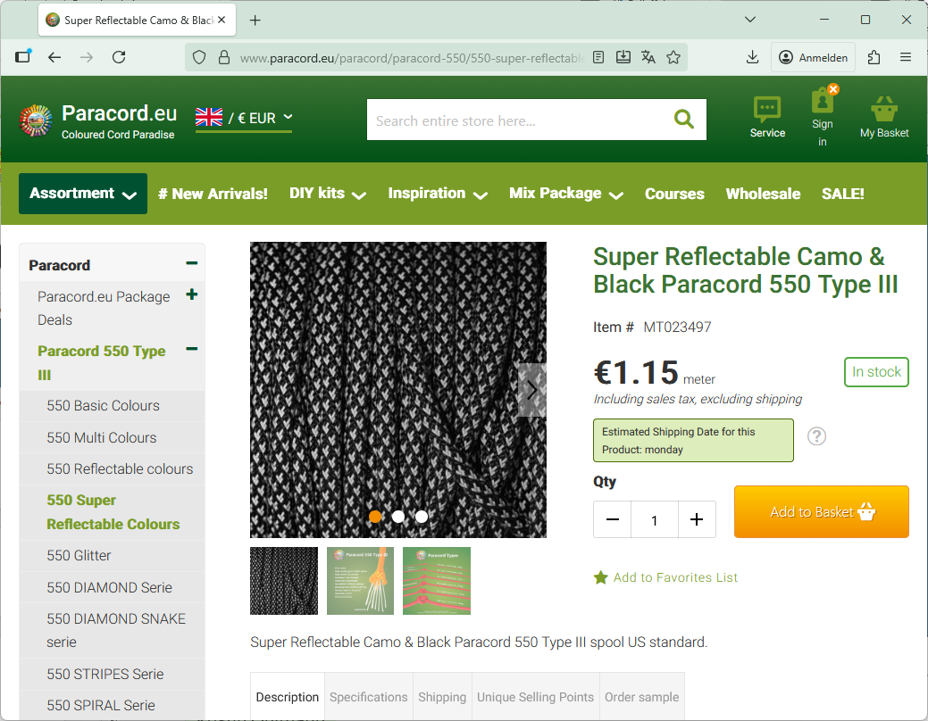
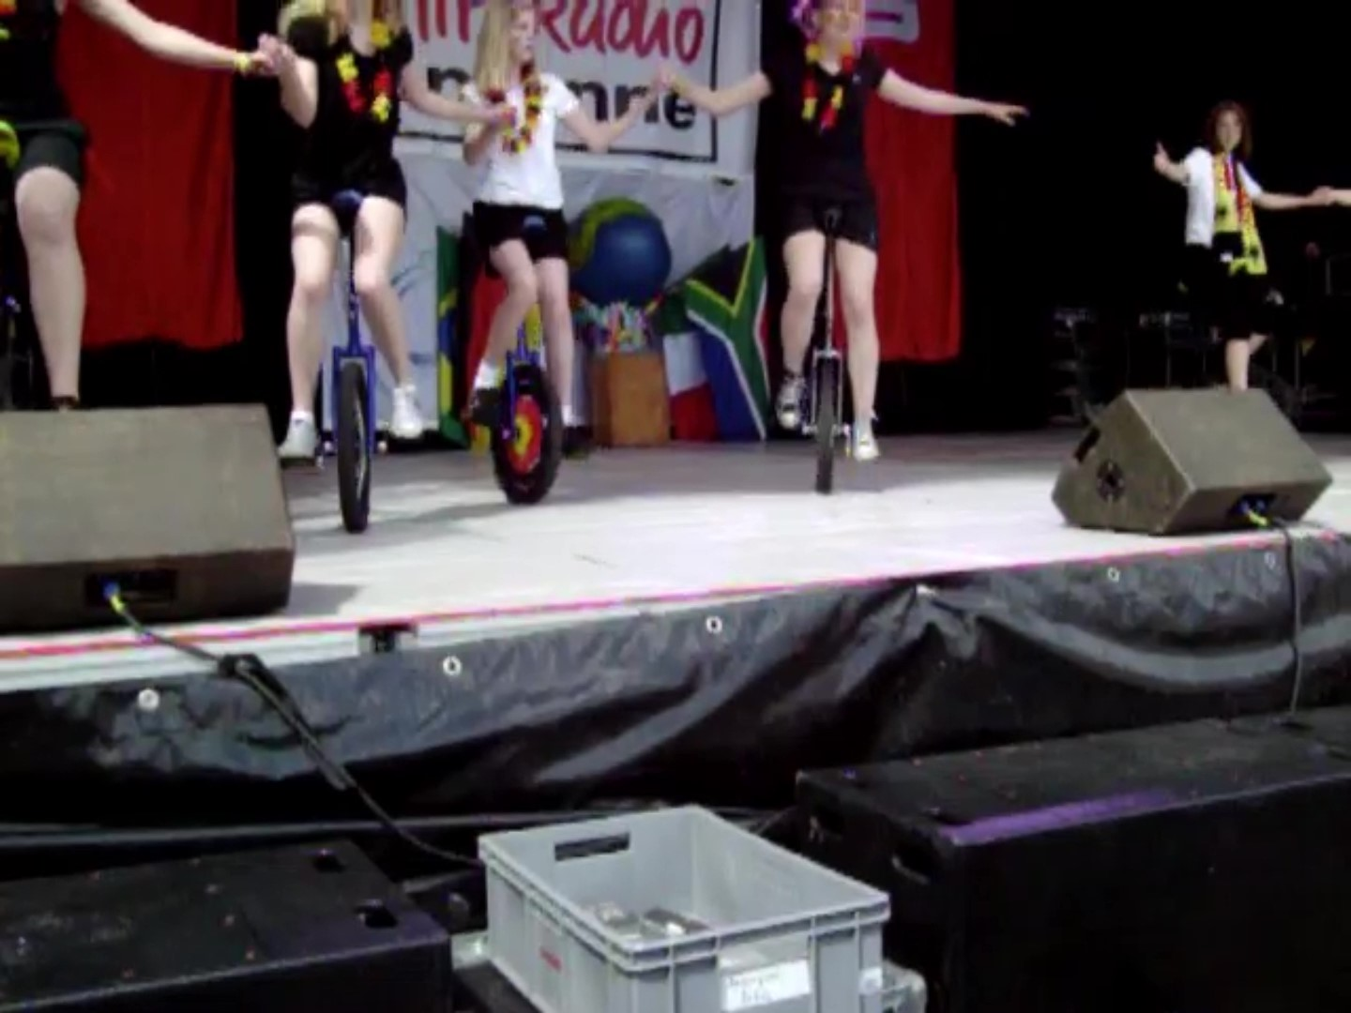
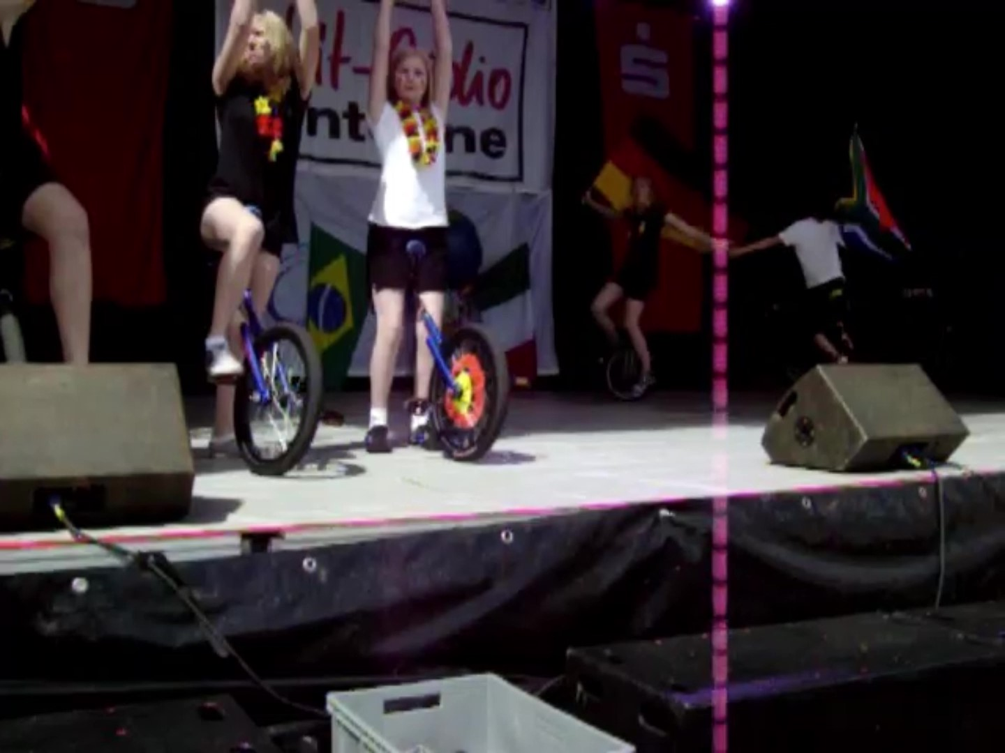
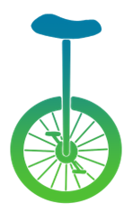
Notes:
I hunted down some old photos of me and that unicycle, back from when I was eleven.
As you can see, I threaded strips of crepe paper through the spokes in whatever pattern I felt like at the time.
Surely that also works with things other than crepe paper, right? Like … reflective rope!?
So, I started planning…

Slide 3

9
Notes:
I did want some sort of pattern [ANIMATE].
And of course, a unicycle is, essentially, a circle [delete saddle post], so the first pattern that comes to mind is of course the digits of a circle constant. But do I use pi or tau?
The whole point of this was to maximize visibility, so of course I needed to choose the circle constant giving me the larger amount of reflective rope. Could I have just chosen some random rope, calculated the area of the stripes for both tau- and pi-based patterns, and called it a day? Yes!
Did I do that? Of course not!

Slide 4
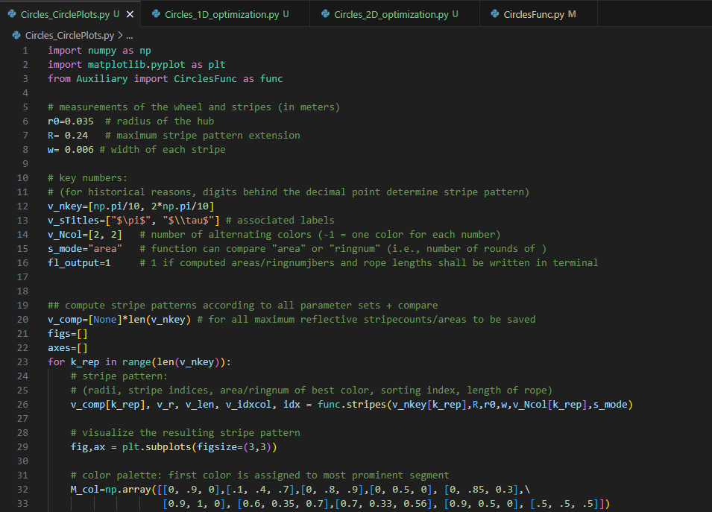
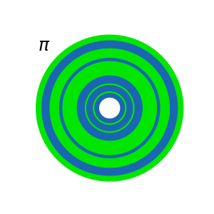
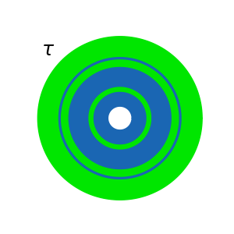
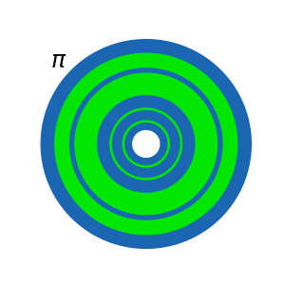
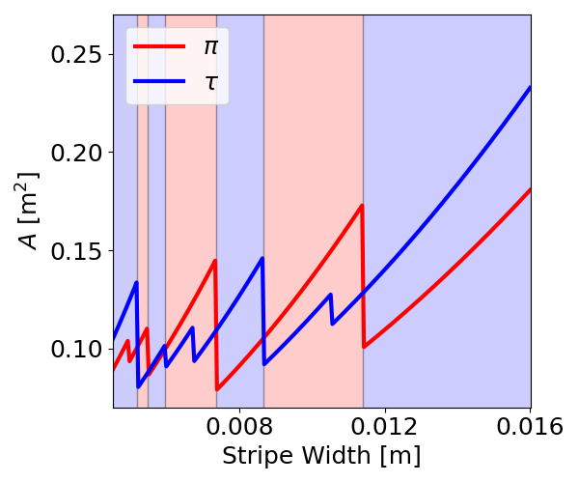
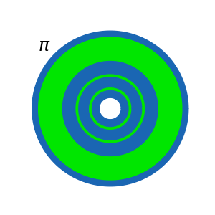
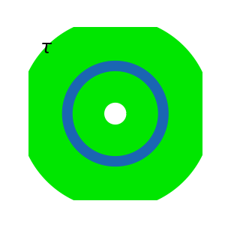
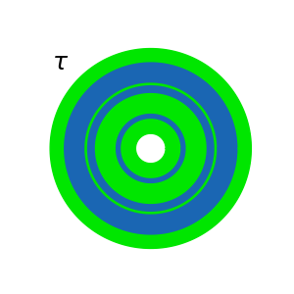
Notes:
Because why make a simple calculation, if you can also write some python code?
So, I wrote a function that calculates the stripes and areas of each color, which gave me some preview pictures like these. [ANIMATE]
Now, I could have just tested some parameters and made a choice. Again, I did not.
Instead, I looked at all possible stripe widths, and how large the area of the dominant color would be, for both pi (in red) and tau (in blue).
Of course, both numbers are effectively random, so neither of them is inherently better and who wins kind of alternates.
But there are some local maxima that look useful.
- The one on the left here [ANIMATE]: Even if it wasn’t my worst option, that one’s just to fiddly. [ANIMATE]
- The two one the right [ANIMATE] would be best if we look at the area, but I was kind of worried that that thick of a rope just would not work very well. So not those either.
That leaves these two here: [ANIMATE]
One with the pattern of pi, one with the pattern of tau. Both of them give me practically the same area. Seems like maths really does not want to make my decoration-decisions for me!
So, I did the thing I especially did NOT plan to do at the start: I decided for the one I thought gave me the prettier pattern… [ANIMATE]

Slide 5
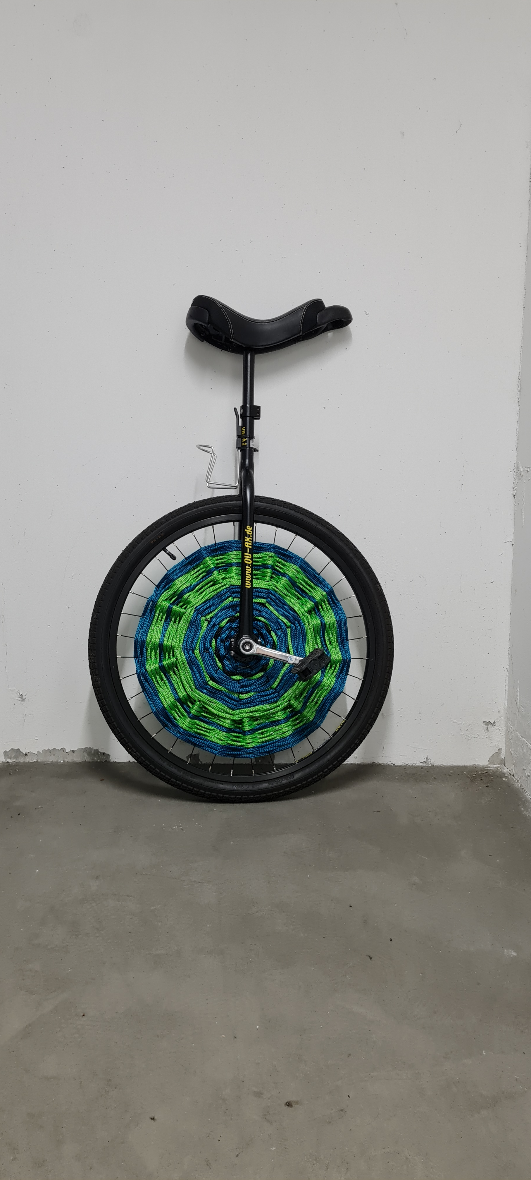
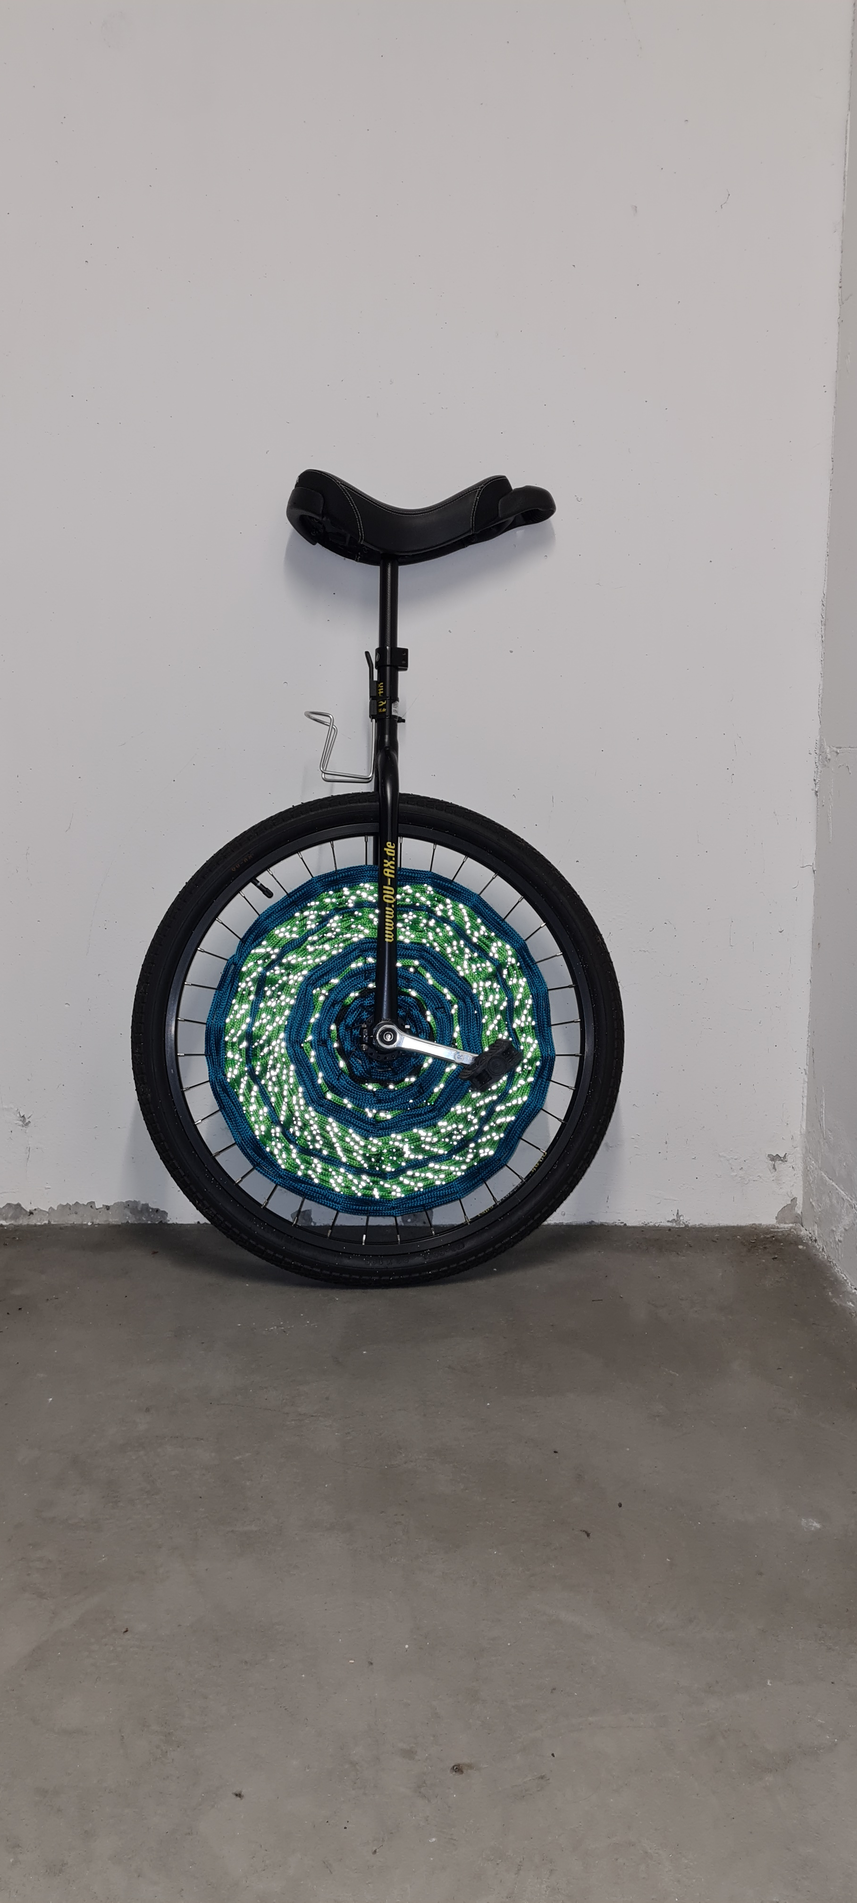

Notes:
The final result then looks like this: Oh, you can‘t really see that it is reflecting? Wait, let me turn on the flash of my camera!
Now, if you were paying VERY close attention you may notice that this is not the solution I had calculated, which looked more like this [ANIMATE PREVIEW PIC].
Turns out when I was just almost finished threading the rope through, I noticed that it might be useful to still have access to the valve…? So I had to stop a bit prematurely.

Slide 6
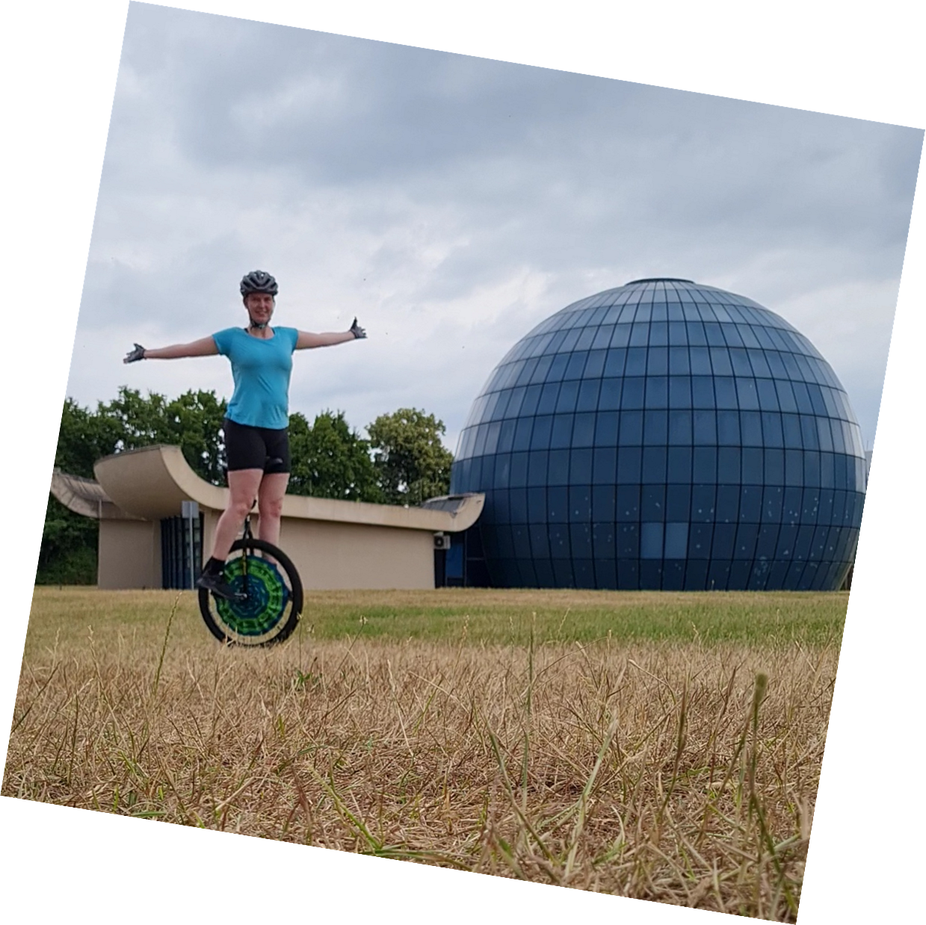
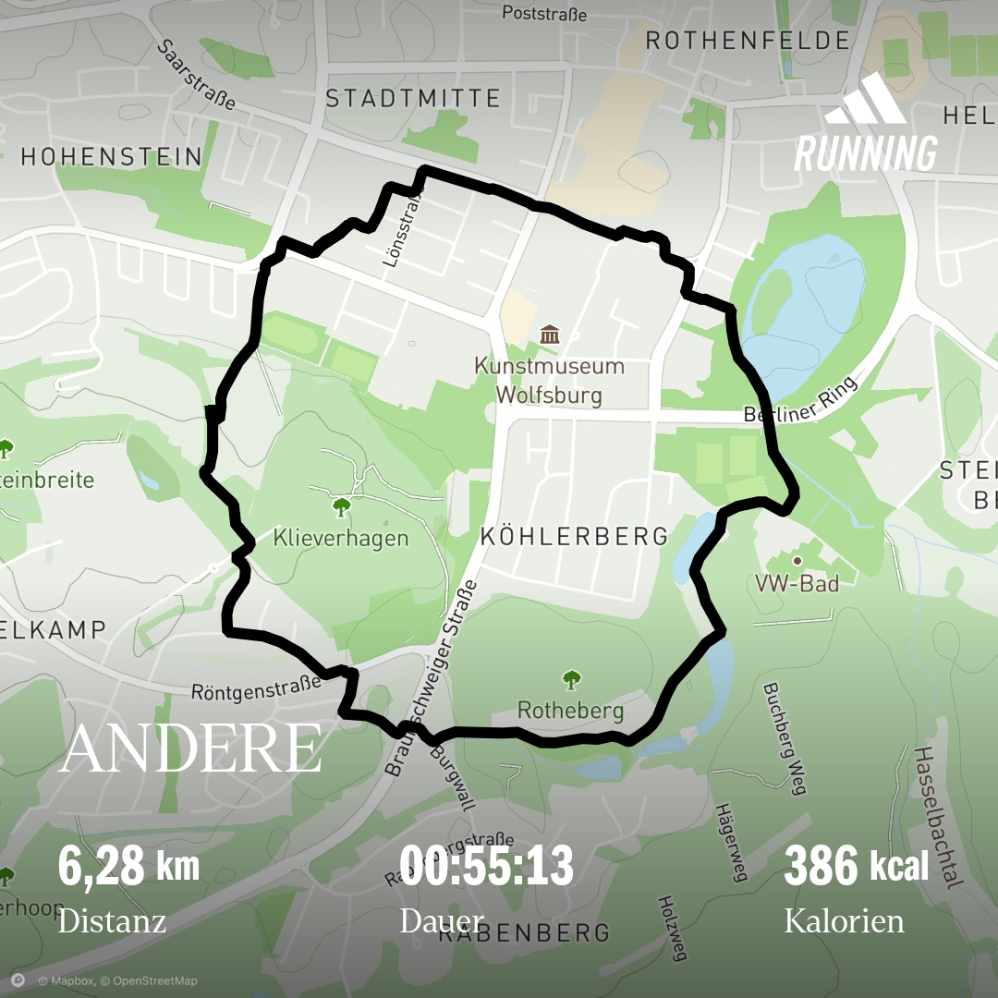
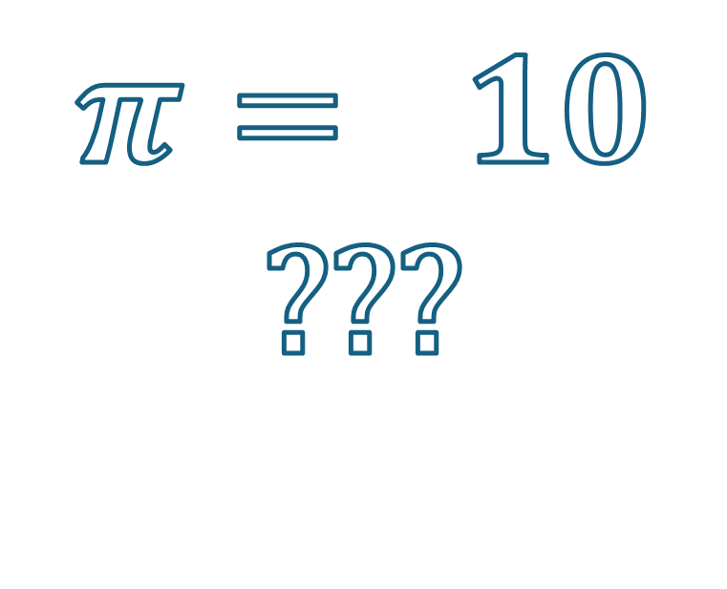
$$π= 10$$
???
Notes:
And, just before I end the talk: Of course, the freshly decorated unicycle needed an appropriate first tour.
So I rode it in a little circle – or as close to a circle as the streets allowed me to – over a distance of 6.28 kilometers, and of course on june 28th, just so tau isn‘t too sad about me choosing pi in the end.
And in the middle of that circle? There‘s a photo of me! On my unicycle! In front of the most spherical building I could find!
Which happens to be a planetarium. So maybe everything I did here was completely in vain and pi was 10 all along!?

Slide 7

cloud.uol.de/s/ 45YkY3GiF5kcoaR
Notes:
Anyways, if you ever need to decorate things in circular stripes, I‘m happy to share the code, and if you want to take ride on probably one of the most mathematical unicycles, let me know, I brought its smaller brother! Also, there‘s still a lot of undecorated space, so if you have any ideas for that, I‘d be happy to discuss those as well.

